Slide 1

Algebra 1
Unit 8, Lesson 1 Identifying Key Features of Quadratic Functions Volume 2, pg. 3

Slide 2


Benchmark
MA.912.AR.3.7
Given a table, equation, or written description of a quadratic function, graph that function, and determine and interpret its key features.
volume 2, pg. 3

Slide 3
Integrated Mathematical Thinking and Reasoning Standards
MA.K12.MTR.2.1 Demonstrate understanding by representing problems in multiple ways.
MA.K12.MTR.4.1 Engage in discussions that reflect on the mathematical thinking of self and others.
MA.K12.MTR.5.1 Use patterns and structure to help understand and connect mathematical concepts.
volume 2, pg. 3

Slide 4

Learning Target
I can identify key features of a quadratic given a graph, a table, or an equation.
volume 2, pg. 3

Slide 5

Warm-Up
volume 2, pg. 3

Slide 6
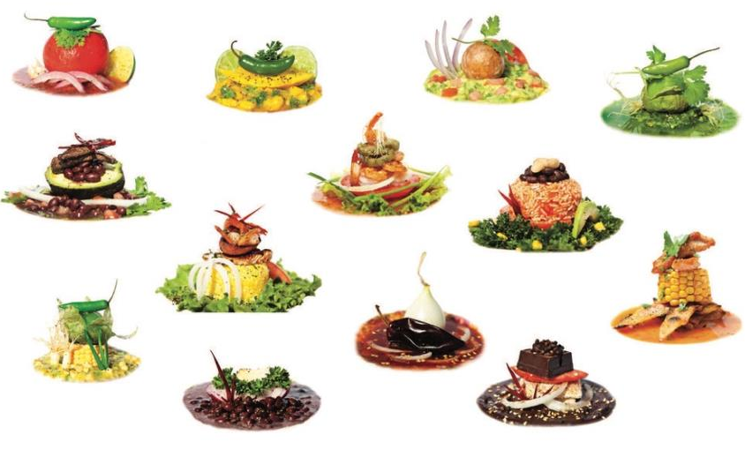

8.1.1 Warm-Up: Food Stylist
Kim Kissling changed careers from working a corporate job to working as a food stylist after learning about the job during a career day at cooking school. As a food stylist, Kim takes photographs for cookbooks, magazines, advertising campaigns, product packaging, and television advertisements.
volume 2, pg. 3

Slide 7
What do you think would be interesting about working as a food stylist?
Kim said two important skills for her job are being super organized and not wasting time. How can you use these skills as a student?
volume 2, pg. 3

Slide 8

Guided Instruction
volume 2, pg. 4

Slide 9

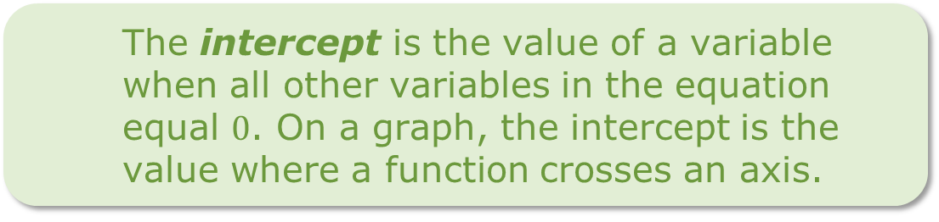
8.1.2 Guided Instruction: Key Features of Quadratics
The graph of a quadratic equation is called a parabola.
The vertex of a parabola is the point where the parabola changes direction.
The intercept is the value of a variable when all other variables in the equation equal $0$. On a graph, the intercept is the value where a function crosses an axis.
volume 2, pg. 4

Slide 10
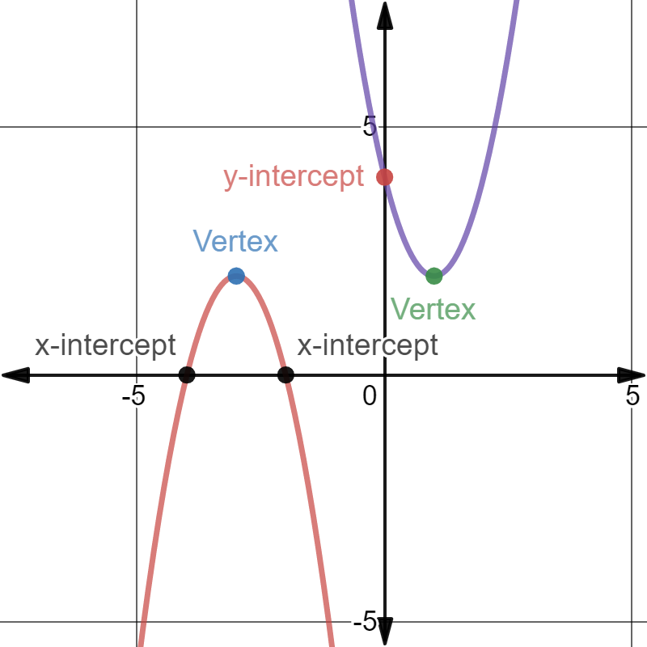
Work with your partner to describe the red and purple parabolas. Note any similarities or differences.
volume 2, pg. 4

Slide 11
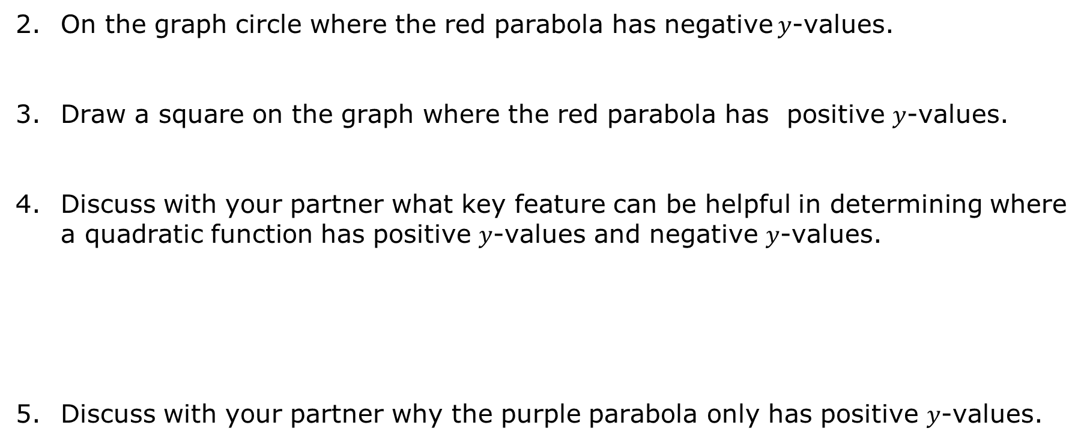
On the graph circle where the red parabola has negative $y$-values.
Draw a square on the graph where the red parabola has positive $y$-values.
Discuss with your partner what key feature can be helpful in determining where a quadratic function has positive $y$-values and negative $y$-values.
Discuss with your partner why the purple parabola only has positive $y$-values.
volume 2, pg. 4

Slide 12
Every parabola has a line of symmetry. Draw the line of symmetry for the red and purple parabolas.
What do you notice about the two lines of symmetry?
A line of symmetry is a line that divides a figure into two congruent parts, so that the reflection of either part across the line maps precisely onto the other.
volume 2, pg. 4

Slide 13

Collaboration
volume 2, pg. 5

Slide 14

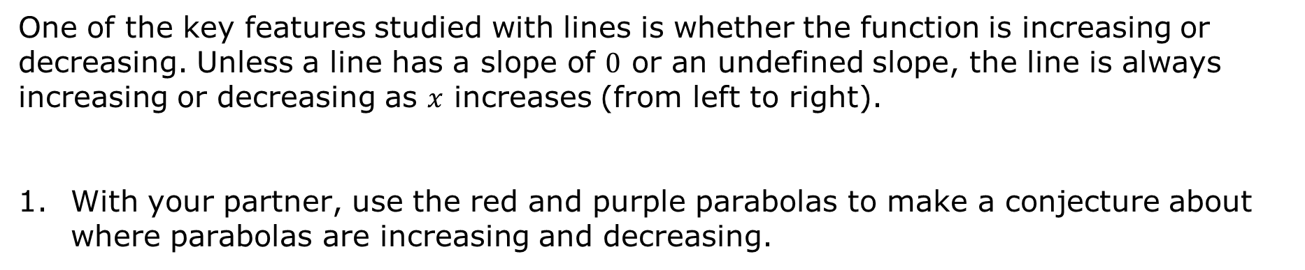
8.1.3 Collaboration: Key Features of Quadratics Using Equations
One of the key features studied with lines is whether the function is increasing or decreasing. Unless a line has a slope of $0$ or an undefined slope, the line is always increasing or decreasing as $x$ increases (from left to right).
With your partner, use the red and purple parabolas to make a conjecture about where parabolas are increasing and decreasing.
volume 2, pg. 5

Slide 15
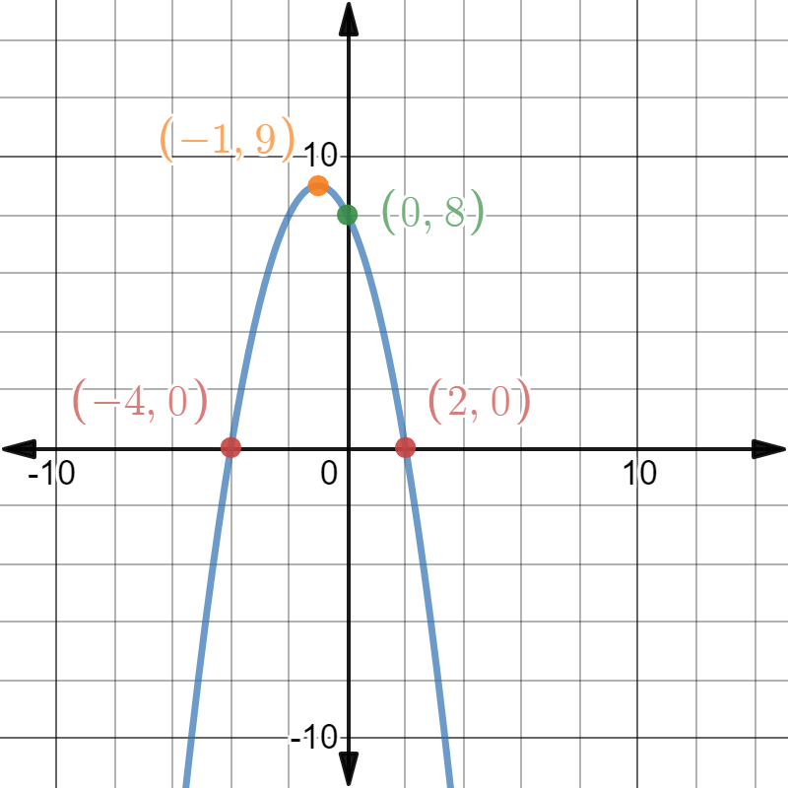
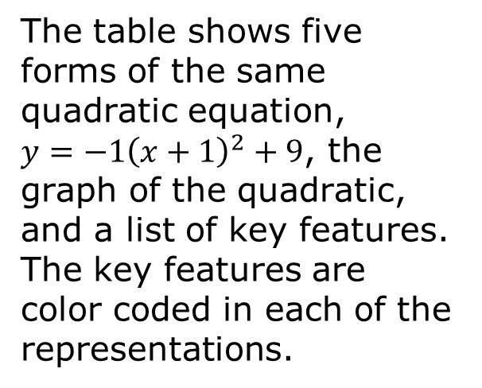
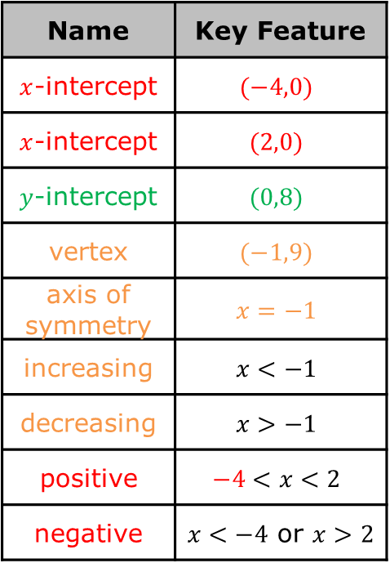

The table shows five forms of the same quadratic equation,
$y=−1{\left(x+1\right)}^{2}+9$, the graph of the quadratic, and a list of key features. The key features are color coded in each of the representations.
$$y=−1{\left(x−\left(−1\right)\right)}^{2}+9$$
$$y=−1{\left(x+1\right)}^{2}+9$$
$$y=−1\left(x−\left(−4\right)\right)\left(x−2\right)$$
$$y=−1\left(x+4\right)\left(x−2\right)$$
$$y=−1x^{2}−2x+8$$
Name | Key Feature
$x$-intercept | $$(−4,0)$$
$x$-intercept | $$(2,0)$$
$y$-intercept | $$(0,8)$$
vertex | $$(−1,9)$$
axis of symmetry | $$x=−1$$
increasing | $$x<−1$$
decreasing | $$x>−1$$
positive | $$−4<x<2$$
negative | $x<−4$ or $x>2$
volume 2, pg. 5

Slide 16
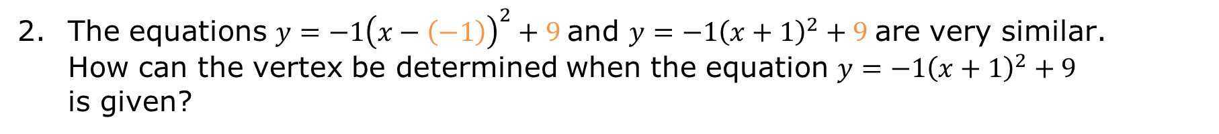
The equations $y=−1{\left(x−\left(−1\right)\right)}^{2}+9$ and $y=−1{\left(x+1\right)}^{2}+9$ are very similar. How can the vertex be determined when the equation $y=−1{\left(x+1\right)}^{2}+9$ is given?
volume 2, pg. 5

Slide 17
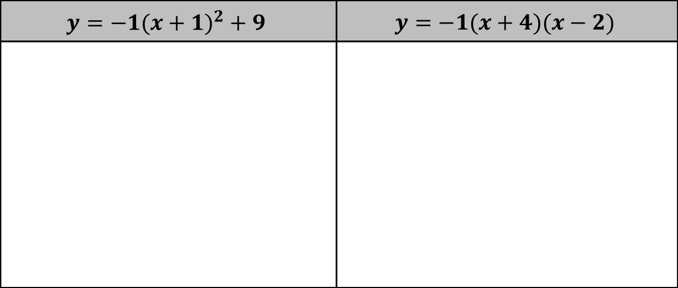
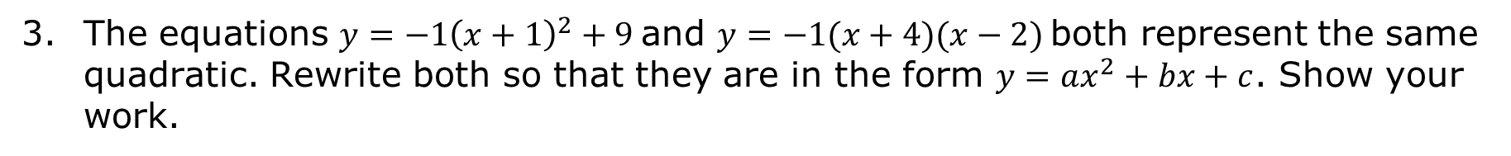
The equations $y=−1{\left(x+1\right)}^{2}+9$ and $y=−1(x+4)(x−2)$ both represent the same quadratic. Rewrite both so that they are in the form $y=ax^{2}+bx+c$. Show your work.
$$y={−1(x+1)}^{2}+9$$ | $$y=−1(x+4)(x−2)$$
volume 2, pg. 6

Slide 18
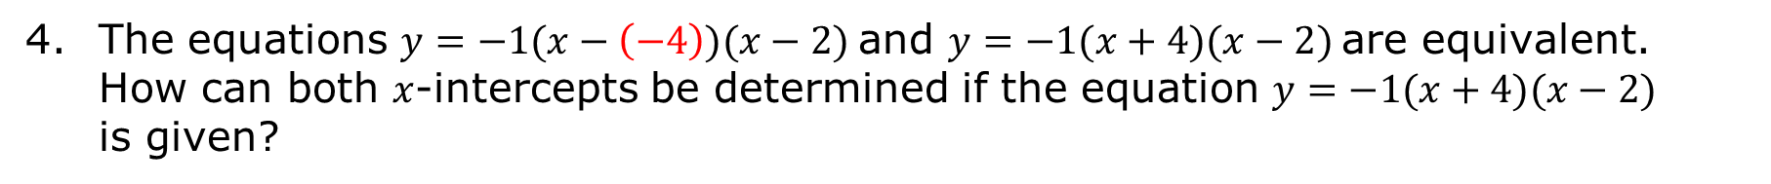
The equations $y=−1(x−\left(−4\right))(x−2)$ and $y=−1(x+4)(x−2)$ are equivalent. How can both $x$-intercepts be determined if the equation $y=−1(x+4)(x−2)$ is given?
volume 2, pg. 6

Slide 19
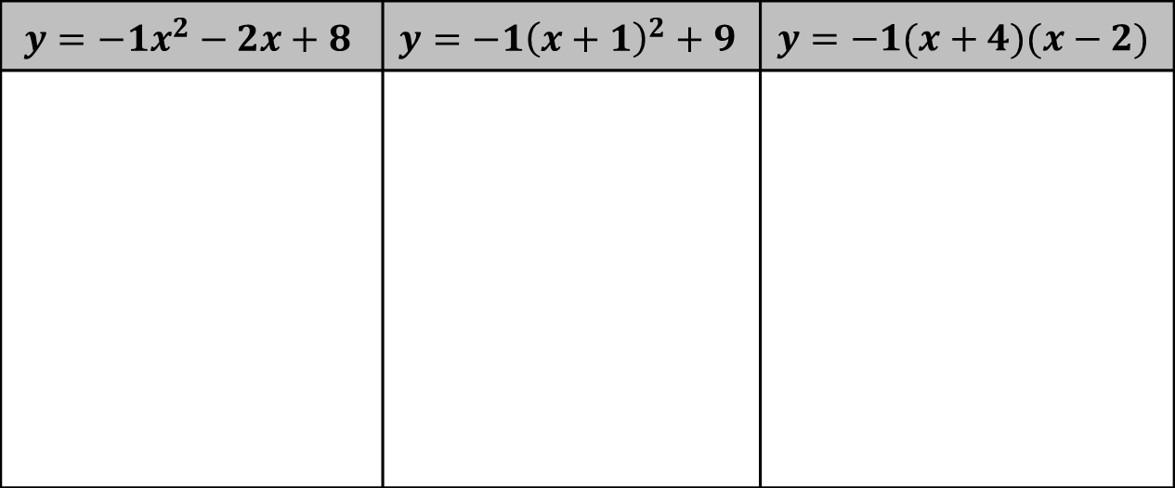
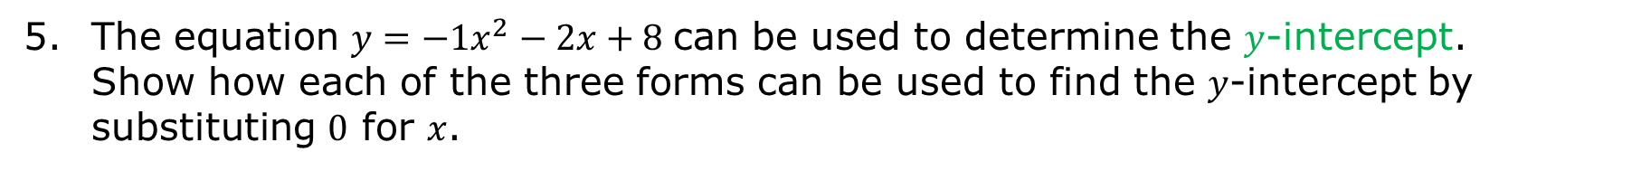
The equation $y=−1x^{2}−2x+8$ can be used to determine the $y$-intercept. Show how each of the three forms can be used to find the $y$-intercept by substituting $0$ for $x$.
$$y=−1x^{2}−2x+8$$ | $$y=−1{\left(x+1\right)}^{2}+9$$ | $$y=−1(x+4)(x−2)$$
volume 2, pg. 6

Slide 20
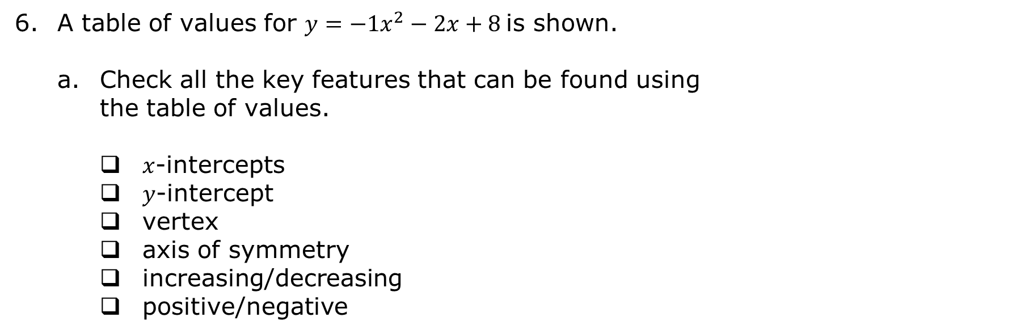
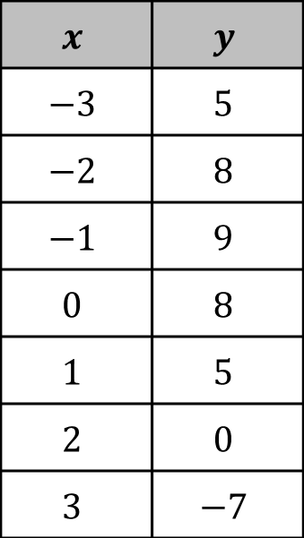
A table of values for $y=−1x^{2}−2x+8$ is shown.
Check all the key features that can be found using the table of values.
$x$-intercepts
$y$-intercept
vertex
axis of symmetry
increasing/decreasing
positive/negative
$$x$$ | $$y$$
$$−3$$ | $$5$$
$$−2$$ | $$8$$
$$−1$$ | $$9$$
$$0$$ | $$8$$
$$1$$ | $$5$$
$$2$$ | $$0$$
$$3$$ | $$−7$$
volume 2, pg. 6

Slide 21
Discuss with your partner the key features that were not found, but that could be found if the table of values included more values.
volume 2, pg. 6

Slide 22
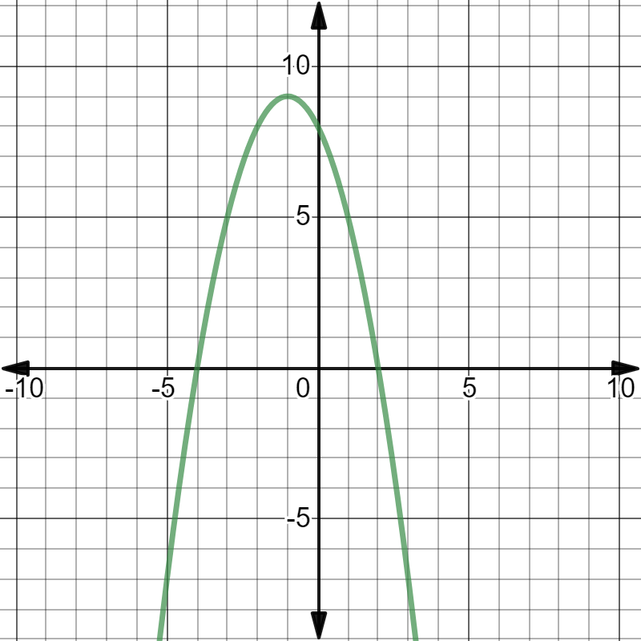
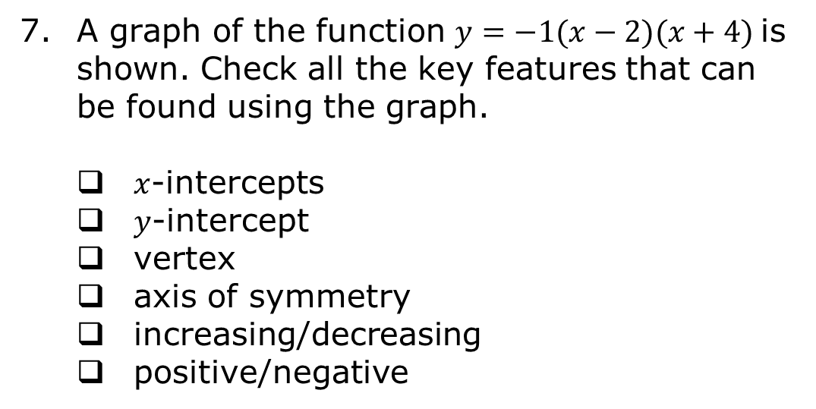
A graph of the function $y=−1(x−2)(x+4)$ is shown. Check all the key features that can be found using the graph.
$x$-intercepts
$y$-intercept
vertex
axis of symmetry
increasing/decreasing
positive/negative
volume 2, pg. 7

Slide 23
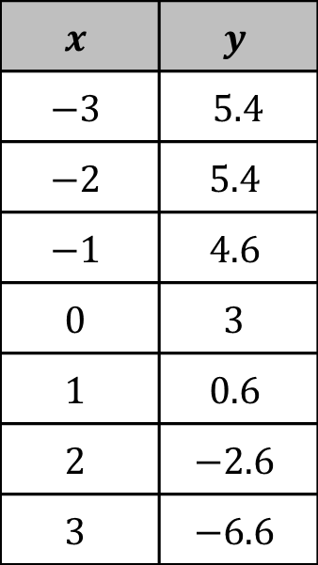
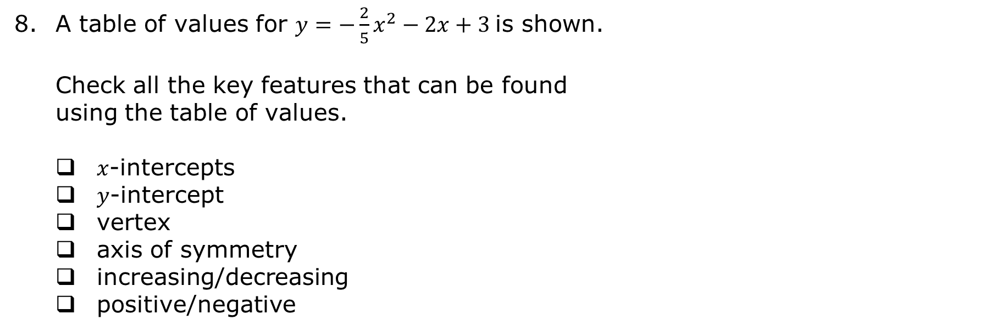
A table of values for $y=−\frac{2}{5}x^{2}−2x+3$ is shown.
Check all the key features that can be found using the table of values.
$x$-intercepts
$y$-intercept
vertex
axis of symmetry
increasing/decreasing
positive/negative
$$x$$ | $$y$$
$$−3$$ | $5$.4
$$−2$$ | $$5.4$$
$$−1$$ | $$4.6$$
$$0$$ | $$3$$
$$1$$ | $$0.6$$
$$2$$ | $$−2.6$$
$$3$$ | $$−6.6$$
volume 2, pg. 7

Slide 24
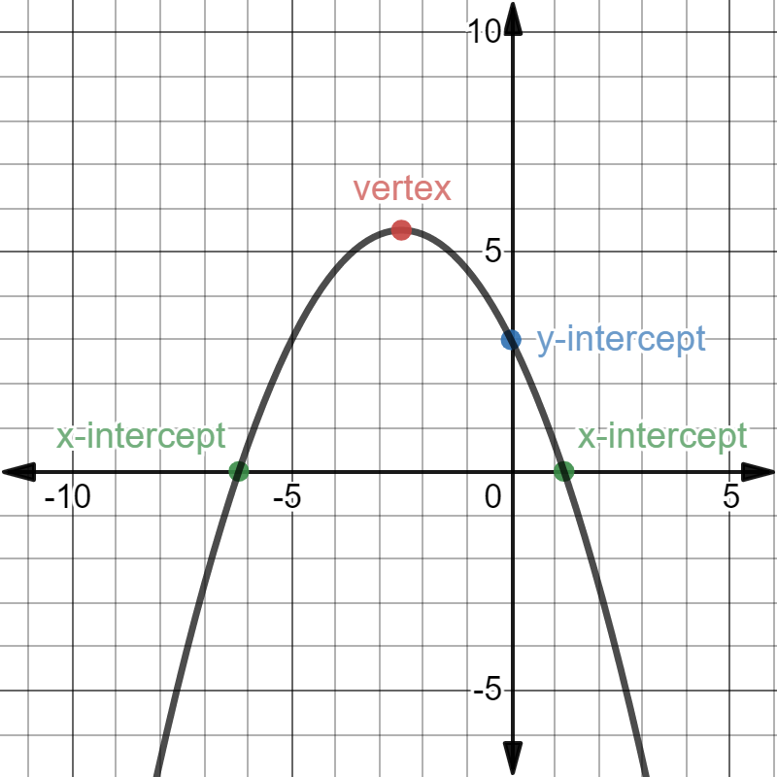
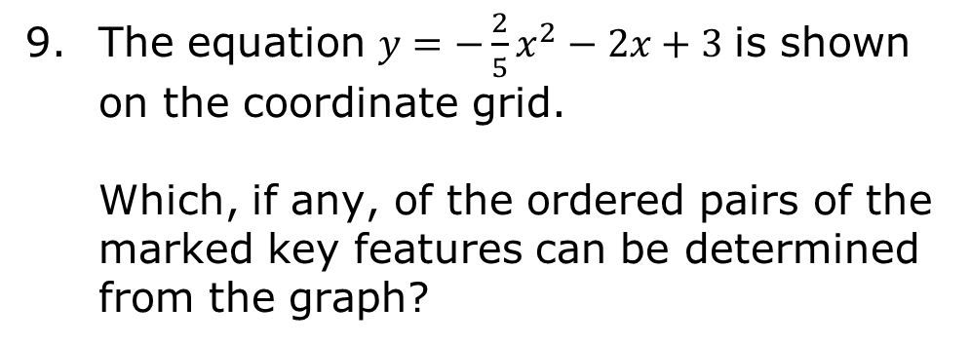
The equation $y=−\frac{2}{5}x^{2}−2x+3$ is shown on the coordinate grid.
Which, if any, of the ordered pairs of the marked key features can be determined from the graph?
volume 2, pg. 7

Slide 25

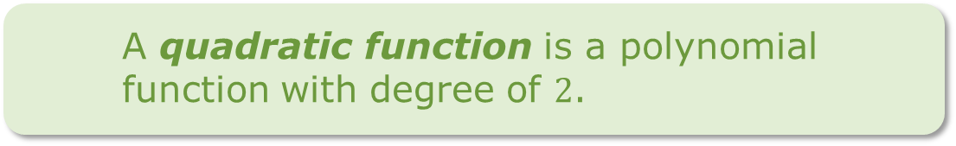
Determining all of the key features of a quadratic may require using a graph, different forms of an equation, and a table of values.
A quadratic function is a polynomial function with degree of $2$.
volume 2, pg. 7

Slide 26

Guided Practice
volume 2, pg. 8

Slide 27

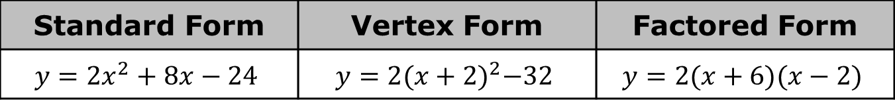
8.1.4 Guided Practice: Key Features of Quadratics Using Equations
Three different equations for a quadratic function are given.
Use the equations to determine the key features. If an equation cannot be used to determine a key feature write “no equation.”
Standard Form | Vertex Form | Factored Form
$$y=2x^{2}+8x−24$$ | $$y=2{(x+2)}^{2}−32$$ | $$y=2(x+6)(x−2)$$
volume 2, pg. 8

Slide 28
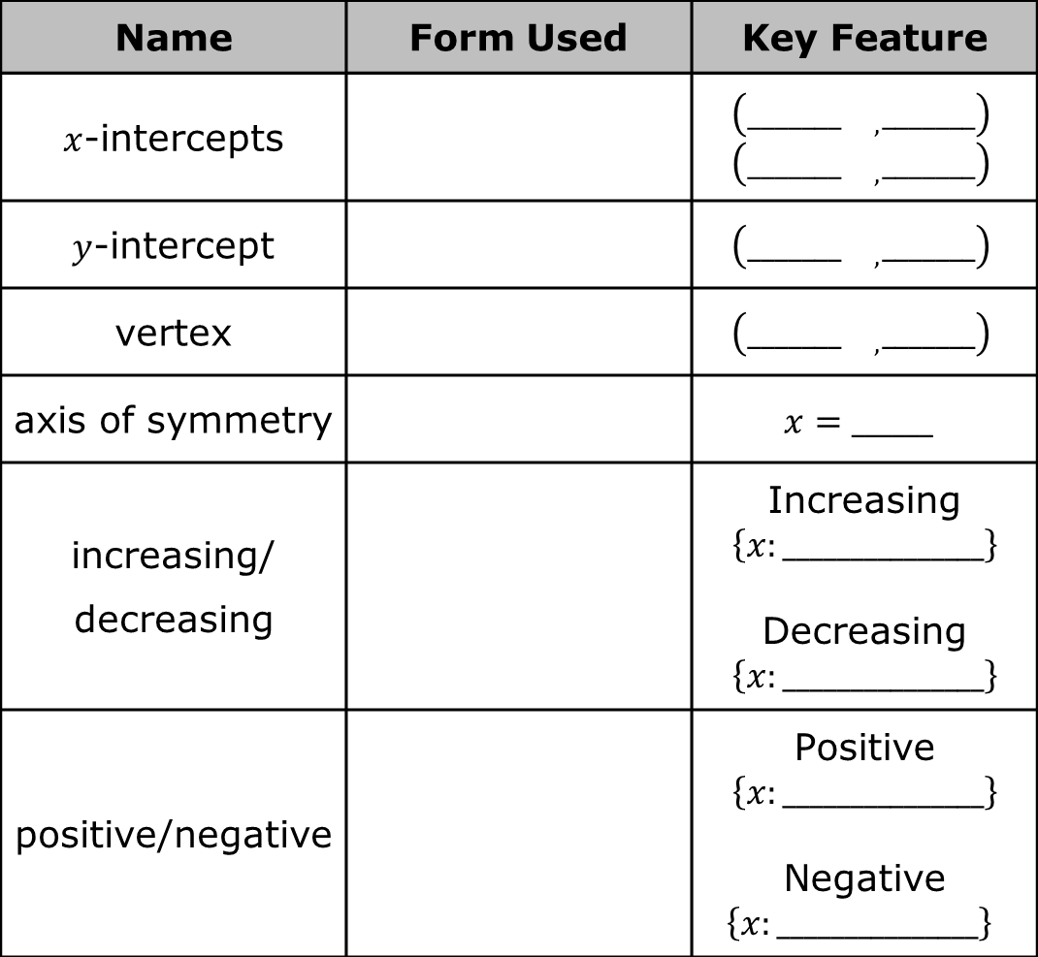
Name | Form Used | Key Feature
$x$-intercepts |  | $$\left(_______{}_{,}_______\right)$$ $$\left(_______{}_{,}_______\right)$$
$y$-intercept |  | $$\left(_______{}_{,}_______\right)$$
vertex |  | $$\left(_______{}_{,}_______\right)$$
axis of symmetry |  | $$x=______$$
increasing/ decreasing |  | Increasing $$\left\{x:_______________\right\}$$ Decreasing $$\left\{x:_______________\right\}$$
positive/negative |  | Positive $$\left\{x:_______________\right\}$$ Negative $\left\{x:_______________\right\}$
volume 2, pg. 8

Slide 29
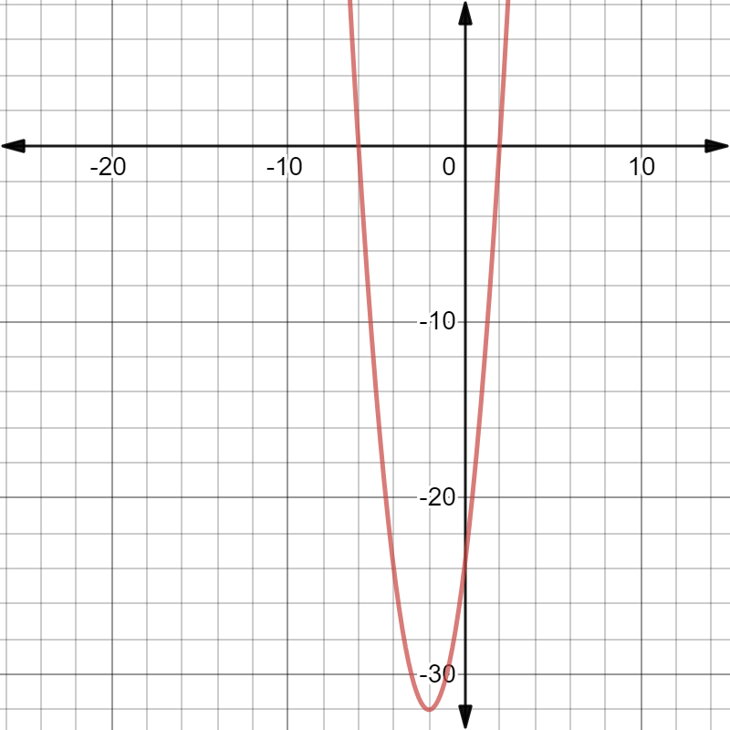
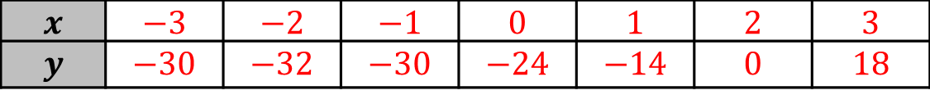
Label the key features on the graph of $y=2x^{2}+8x−24$. Then, if possible, circle the key feature in the table of values.
$$x$$ | $$−3$$ | $$−2$$ | $$−1$$ | $$0$$ | $$1$$ | $$2$$ | $$3$$
$$y$$ | $$−30$$ | $$−32$$ | $$−30$$ | $$−24$$ | $$−14$$ | $$0$$ | $$18$$
volume 2, pg. 8

Slide 30

Wrap-Up
volume 2, pg. 9

Slide 31
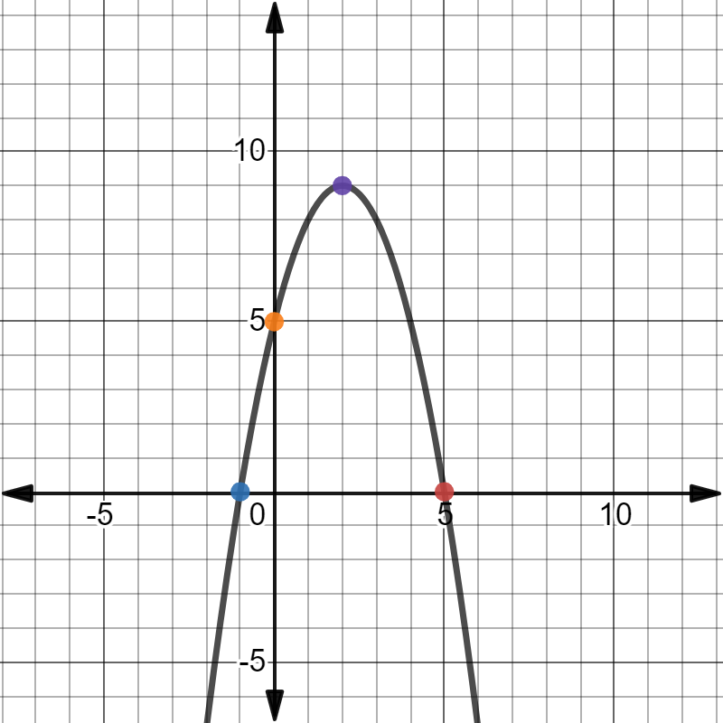
8.1.5 Wrap-Up: Cool Down
The graph of a quadratic equation is shown. Label the four colored points on the parabola with the ordered pair.
Use words, ordered pairs, or symbols to describe the location of each key feature on the given parabola.
volume 2, pg. 9

Slide 32
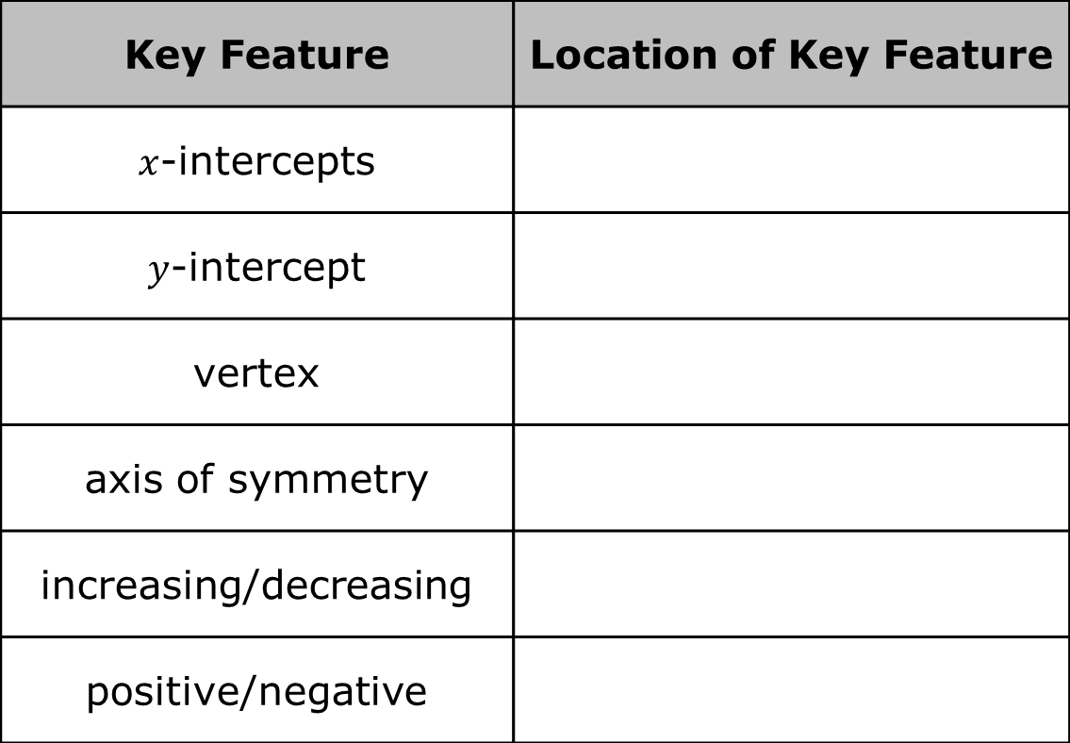
Key Feature | Location of Key Feature
$x$-intercepts
$y$-intercept
vertex
axis of symmetry
increasing/decreasing
positive/negative
volume 2, pg. 9

